Slide 1
Capstone Project - 2
Appliances Energy Prediction Team Members Manoj Patil M Bindu Kovvada Gulzar Saksham Tripathi Deepak Kumar Gautam

Slide 2

Table of content
Importing the Relevant Libraries
Data Inspection
Exploratory Data Analysis
Feature selection
Feature engineering
Train and Test split
Model training
Cross validation
Model Explainability
Conclusion

Slide 3

Problem Statement
The data set is at 10 min for about 4.5 months. The house temperature and humidity conditions were monitored with a ZigBee wireless sensor network. Each wireless node transmitted the temperature and humidity conditions around 3.3 min. Then, the wireless data was averaged for 10 minutes periods. The energy data was logged every 10 minutes with mbus energy meters. Weather from the nearest airport weather station (Chievres Airport, Belgium) was downloaded from a public data set from Reliable Prognosis (rp5.ru) and merged together with the experimental data sets using the date and time column. Two random variables have been included in the data set for testing the regression models and to filter out non-predictive attributes (parameters).

Slide 4

Objective
Energy usage is rapidly increasing in today's world. We are experiencing a lack of energy due to the increased energy consumption in some regions of the world, which is causing environmental damage. Our main purpose in this project is to analyse what factors are affecting the increase energy consumption of home appliances, how we may reduce energy consumption of home appliances, and predict energy consumption of appliances using regression models.

Slide 5
Data set information
Columns Used:
Date time year-month-day hour:minute:second
Appliances, energy use in Wh
Lights, energy use of light fixtures in the house in Wh
T1, Temperature in kitchen area, in Celsius
RH_1, Humidity in kitchen area, in %
T2, Temperature in living room area, in Celsius
RH_2, Humidity in living room area, in %
T3, Temperature in laundry room area
RH_3, Humidity in laundry room area, in %
T4, Temperature in office room, in Celsius
RH_4, Humidity in office room, in %
T5, Temperature in bathroom, in Celsius
RH_5, Humidity in bathroom, in %
T6, Temperature outside the building (north side), in Celsius
RH_6, Humidity outside the building (north side), in %

Slide 6
16. T7, Temperature in ironing room , in Celsius
17. RH_7, Humidity in ironing room, in %
18. T8, Temperature in teenager room 2, in Celsius
19. RH_8, Humidity in teenager room 2, in %
20. T9, Temperature in parents room, in Celsius
21. RH_9, Humidity in parents room, in %
22. To, Temperature outside (from Chievres weather station), in Celsius
23. Pressure (from Chievres weather station), in mm Hg
24. RH_out, Humidity outside (from Chievres weather station), in %
25. Wind speed (from Chievres weather station), in m/s
26. Visibility (from Chievres weather station), in km
27. Tdewpoint (from Chievres weather station), Â°C
28. rv1, Random variable 1, nondimensional
29. rv2, Random variable 2, nondimensional

Slide 7
Data Inspection
From the statistics part of our data we can observe:
There are 29 columns and 19735 rows in our dataset.
The maximum energy consumption of the appliance is 1080 watts, while the minimum is 10 watts.
The majority of the data in the light column are 0 values.
The maximum pressure outside the home is 772.3 mm hg.
There are no categorical columns in the dataset other than the date column.
Average temperature outside is about 7.5 degrees. While it ranges from -6 to 28 degrees.
There are no null or missing values.
Outside humidity is higher than inside humidity.
The maximum wind speed is 14 m/s.

Slide 8
Exploratory Data Analysis
Checking distribution of target variable
Observation:
Since our graph is positively skewed, it is moving towards the y axis, and we couldn't get a better visualisation with this type of graph. As a result, it is better to apply a Log, Square Root, or Exponential transformation and check the dependent variable's distribution.

Slide 9
To check the distribution using Log transformation method on dependent variable
Observation:
It almost has a normal distribution after the log10 transformation.

Slide 10
Checking distribution of all the features
Except for lights, T2, RH6, RH out, windspeed, rv1 and rv2,
the rest columns are normally distributed.

Slide 11
Observation
Positively skewed(>1):- Appliances, RH_5.
Moderately Positively skewed(0.5 to 1):- T2, T5, T6, T_out, RH_out, Windspeed.
Normal Distributed(-0.5 to +0.5):- T1, T3, T4, T7, T8, T9, RH_1, RH_2, RH_3, RH_4, RH_6, RH_7, RH_8, RH_9, Press_mm_hg, Visibility, Tdewpoint, rv1, rv2,
Negative skewed(-0.5 to -1):- No features.
Moderately Negatively skewed(>-1):- RH_out.

Slide 12
Checking which day of week has more energy consumption?
0 - Sunday has a higher energy consumption rate, which indicates that more individuals are at home on Sunday.

Slide 13
Energy consumption vs Date
In the month of March, we can clearly see that appliances consume more energy, whereas in the month of January, appliances consume less energy.

Slide 14
Feature selection
Removing Date and Light column
Date dropping reason: Since we're not trying to analyse the problem as a Time Series, we shall regress on the "Appliance" column.
Feature selection for numerical features using f_regression.
Dropping T9, RH_4, RH_5, months, Tdewpoint, Visibility, rv1, rv2 and week_days columns.

Slide 15
Correlation feature selection

Slide 16
Observations based on correlation plot
Temperature - All the temperature variables from T1-T9 and T_out have positive correlation with the target Appliances.
For the indoor temperatures, the correlations are high as expected, since the ventilation is driven by the HRV unit and minimizes air temperature differences between rooms.
Five columns have a high degree of correlation with T9 - T3,T4,T5,T7,T8 also T6 & T_Out has high correlation(both temperatures from outside) . Hence T6 and T9 can be removed from training set as information provided by them can be provided by other fields.
Weather attributes - Visibility, Tdewpoint, Press_mm_hg have low correlation values
Humidity -There are no significantly high correlation cases (> 0.9) for humidity sensors.
Random variables have no role to play

Slide 17
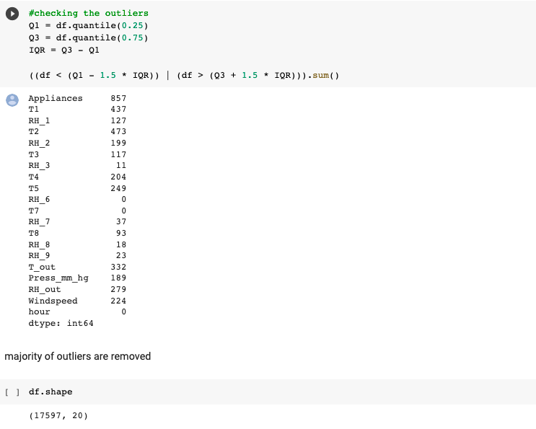
Feature Engineering
Checking outliers

Slide 18
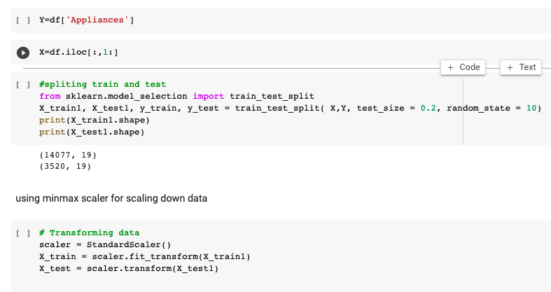
Test and Train split

Slide 19
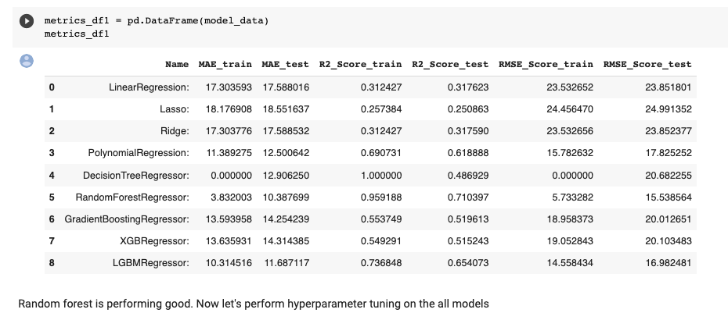
Fitting the multiple models

Slide 20
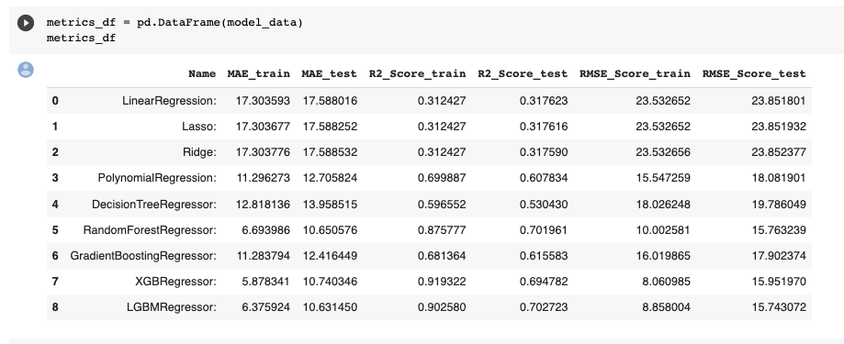
Cross validation and hyperparameter tuning

Slide 21
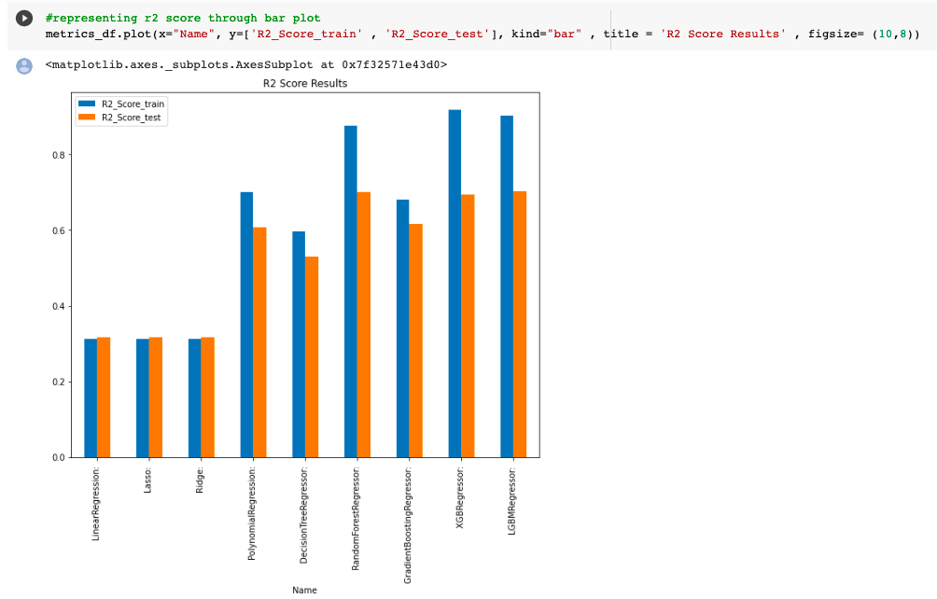
Representing r2 score through bar plot

Slide 22
Observation
From above DataFrame we can see LinearRegression is not performing good at all.
XGBRegression is giving r2 value of 0.91 for train data and 0.69 for test data.
LGBMRegression is giving r2 value 0.90 for train data and 0.70 for test data.
RandomForest Regression is giving r2 value of 0.87 train data and 0.70 for test data.
By comparing these models, RandomForest regressor is performing well with a high r2 score and low MSE and RMSE values.

Slide 23
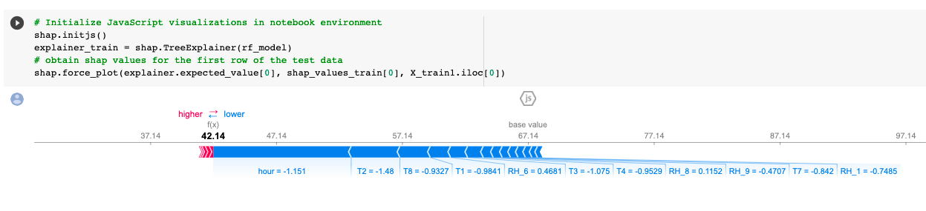
Model Explainability
This plot gives us the explainability of a single model prediction. Force plot can be used for error analysis, finding the explanation to specific instance prediction.

Slide 24
From the plot we can see:
The model output value: 42.14
The base value: this is the value that would be predicted if we didn’t know any features for the current instance. The base value is the average of the model output over the training dataset
The numbers on the plot arrows are the value of the feature for this instance.
Red represents features that pushed the model score higher, and blue representing features that pushed the score lower.
The bigger the arrow, the bigger the impact of the feature on the output.
The amount of decrease or increase in the impact can be seen on the x-axis.

Slide 25
Obtain a Bar Summary Plot

Slide 26
Obtain a dot Summary Plot

Slide 27
Summary:
The summary plot combines the relevance of features with the effects of features. Each point on the summary plot represents a Shapley value for a single instance of a feature. The feature determines the position on the y-axis, and the Shapley value of each instance determines the position on the x-axis. You can see that the most essential feature, the hour, has a high Shapley value range. The colour denotes the feature's value, which ranges from low to high. Overlapping points are jittered in the y-axis direction to give us a sense of the Shapley value distribution per feature. The features are arranged in descending order of importance.

Slide 28
Conclusion
The project's main goal is to predict appliance energy usage. First, we analyse the data. The data set is collected at regular intervals of time, so it is time series data, but we are not implementing time series techniques on the model due to a lack of awareness on time series. (Yet to be taught)
Many columns in the dataset are not normally distributed, and the target column is also right skewed.
The dataset has many outliers and no null values.
We have a high correlation with the dependent variable in the hours column, and many features have less than a 0.1 correlation with the dependent variable in the non linear dataset.
Energy consumption is high in March and low in January, and a rise in temperature results in higher energy consumption.
Decreased humidity leads to an increase in electricity consumption. Humidity is proportional to the dependent variable.
The most important determining factor for energy consumption is the hour of day.
During the evening hours of 16:00 to 20:00, there is a high usage of electricity of more than 140Wh. Electricity use is highest on weekends (Saturdays and Sundays). (more than 25% higher than on weekdays)
As a feature, lights are extremely undervalued.

Slide 29
We excluded features that were not important for predicting the dependent variable using a variance threshold, f regression, and the Pearson correlation matrix. We removed outliers from our model using feature engineering.
Implementing the XGBM and LGBM regression algorithms was done along with cross validation and hyperparameter adjustment on all models. Decision tree, Random forest, Gradient Boosting, and LinearRegression were also used. In a comparison of all models, the RandomForest regressor is the best, having a high r2 score, a low MSE, and a low RMSE value. Due to the time series nature of the dataset and the lack of time series concept implementation, some overfitting is occurring The model explainability Shap approach is used to determine which attributes are crucial for predicting output and understanding the model. The most significant feature is the hour feature.
Improvement points:
Definitely, we have a scope of improvement here, specially in the feature engineering.
We may apply the time series concept to data that we obtain at regular intervals of time and analyse how the accuracy varies.
Since there is just data for one house, analysing several houses will yield vital information.
Additional information may be gained from aspects like the house's geometry and its occupant population over time.
For better data gathering, positioning and sensor quality can be analyzed.

Slide 30
Future Work
Due to the availability of time features, we can do dynamic regression time series modelling. We can use topic modelling to address views in each topic separately.

Slide 31


